Slide 1
BMD ENG 301Quantitative Systems Physiology (Nervous System)
Lecture 11: Neurotransmitters
2022_v1
Professor Malcolm A. MacIver

Slide 2
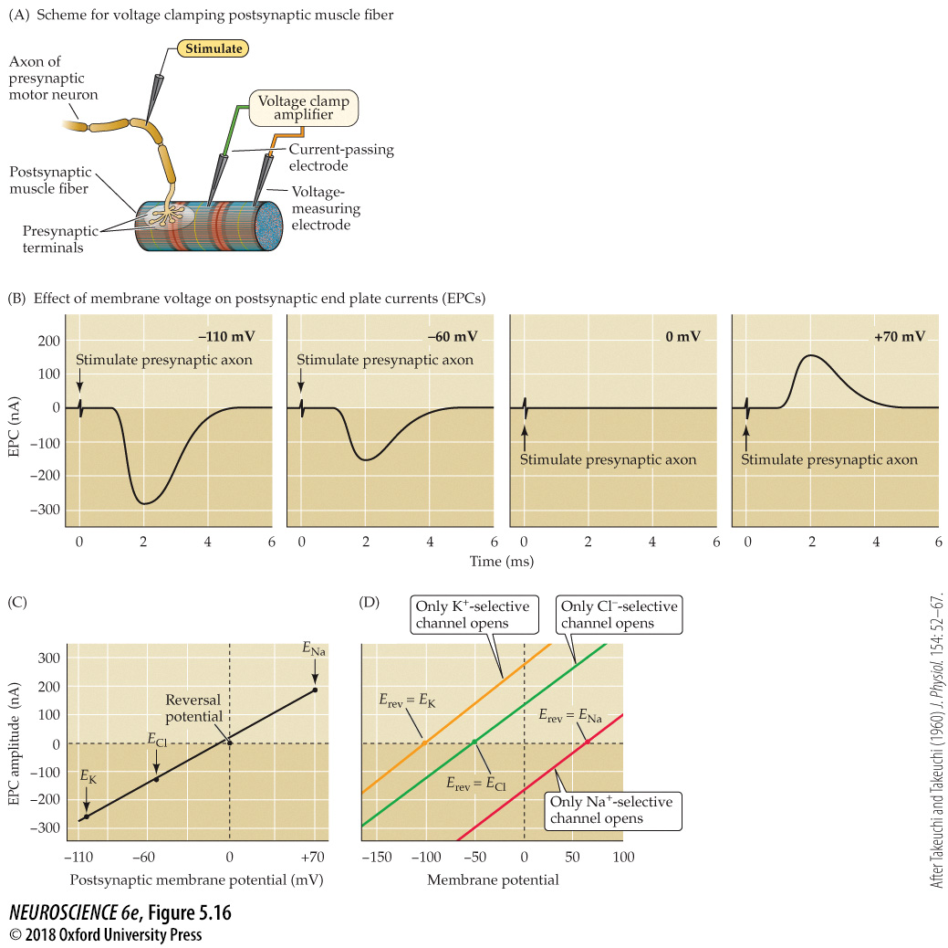
Influence of the postsynaptic membrane potential on end plate currents
Notes:
FIGURE 5.16 Influence of the postsynaptic membrane potential on end plate currents. (A) A postsynaptic muscle fiber is voltage clamped using two electrodes, while the presynaptic neuron is electrically stimulated to cause the release of ACh from presynaptic terminals. This experimental arrangement allows the recording of EPCs produced by ACh. (B) Amplitude and time course of EPCs generated by stimulating the presynaptic motor neuron while the postsynaptic cell is voltage clamped at four different membrane potentials. (C) The relationship between the peak amplitude of EPCs and postsynaptic membrane potential is nearly linear, with a reversal potential (the voltage at which the direction of the current changes from inward to outward) close to 0 mV. Also indicated on this graph are the equilibrium potentials of Na⁺, K⁺, and Cl– ions. (D) The identity of the ions permeating postsynaptic receptors is revealed by the reversal potential (E_{rev}). Activation of postsynaptic channels permeable only to K⁺ (yellow) results in currents reversing at E_{K}, near –100 mV, while activation of postsynaptic Na⁺ channels results in currents reversing at E_{Na}, near +70 mV (red). Cl–-selective currents reverse at E_{Cl}, near –50 mV (green). (A–C after Takeuchi and Takeuchi, 1960.)

Slide 3
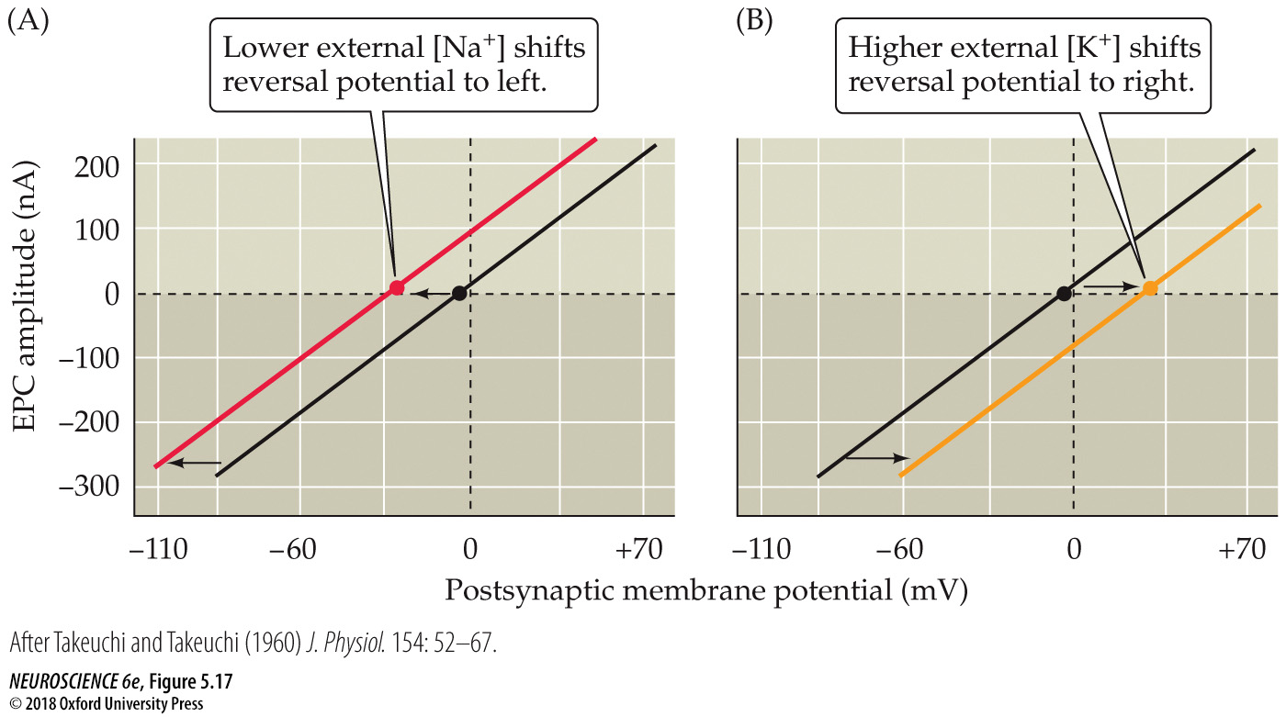
Reversal potential of the end plate current changes when ion gradients change
Notes:
FIGURE 5.17 Reversal potential of the end plate current changes when ion gradients change. (A) Lowering the external Na⁺ concentration causes EPCs to reverse at more negative potentials. (B) Raising the external K⁺ concentration makes the reversal potential more positive. (After Takeuchi and Takeuchi, 1960.)

Slide 4
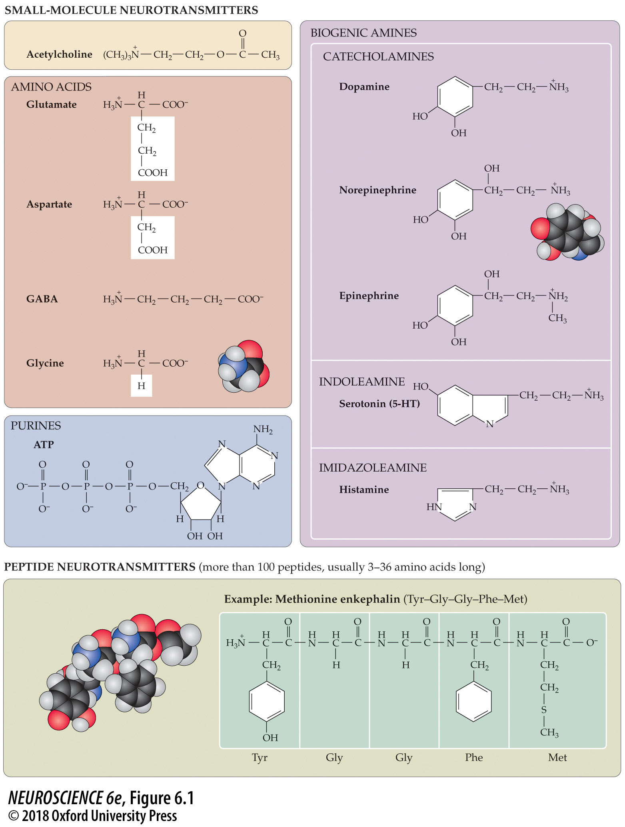
Examples of small-molecule and peptide neurotransmitters
Notes:
FIGURE 6.1 Examples of small-molecule and peptide neurotransmitters. Small-molecule transmitters can be subdivided into acetylcholine, amino acids, purines, and biogenic amines. Size differences between the small-molecule neurotransmitters and the peptide neurotransmitters are indicated by the space-filling models for glycine, norepinephrine, and methionine enkephalin. (Carbon atoms are black, hydrogen gray, nitrogen blue, and oxygen red.)

Slide 5
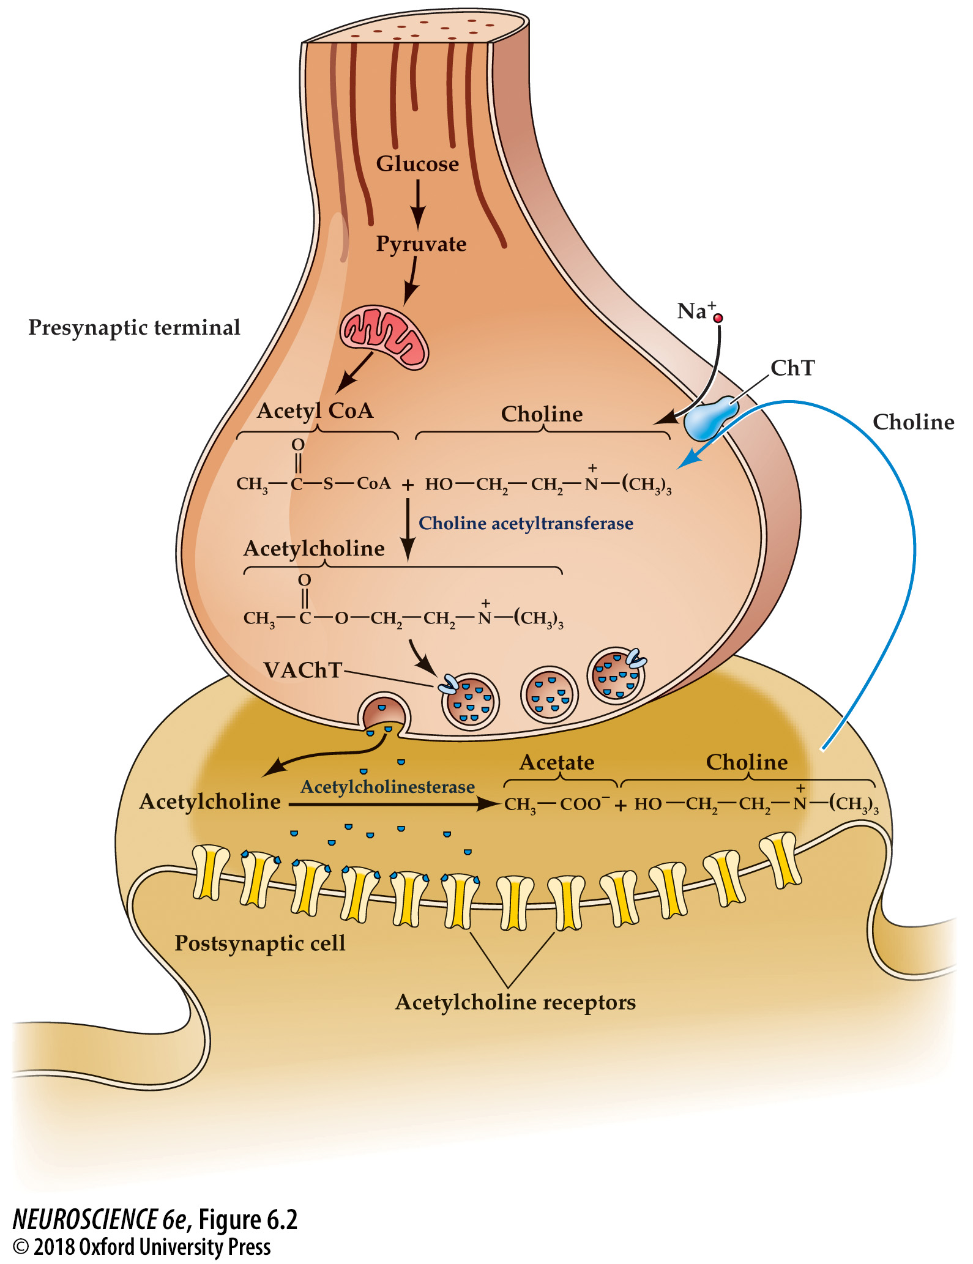
Acetylcholine metabolism in cholinergic nerve terminals
Notes:
FIGURE 6.2 Acetylcholine metabolism in cholinergic nerve terminals. The synthesis of acetylcholine from choline and acetyl CoA requires choline acetyltransferase. Acetyl CoA is derived from pyruvate generated by glycolysis, while choline is transported into the terminals via an Na⁺-dependent co-transporter (ChT). Acetylcholine is loaded into synaptic vesicles via a vesicular transporter (VAChT). After release, acetylcholine is rapidly metabolized by acetylcholinesterase, and choline is transported back into the terminal via the ChT.

Slide 6
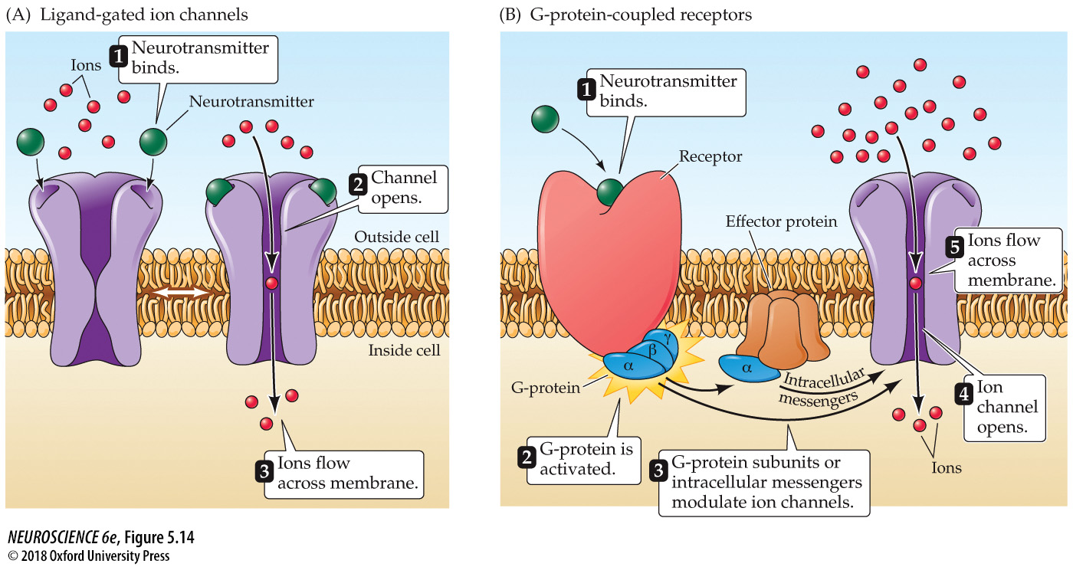
Two different types of neurotransmitter receptors
Notes:
FIGURE 5.14 Two different types of neurotransmitter receptors. (A) Ligand-gated ion channels combine receptor and channel functions in a single protein complex. (B) Metabotropic receptors usually activate G-proteins, which modulate ion channels directly or indirectly through intracellular effector enzymes and second messengers.

Slide 7
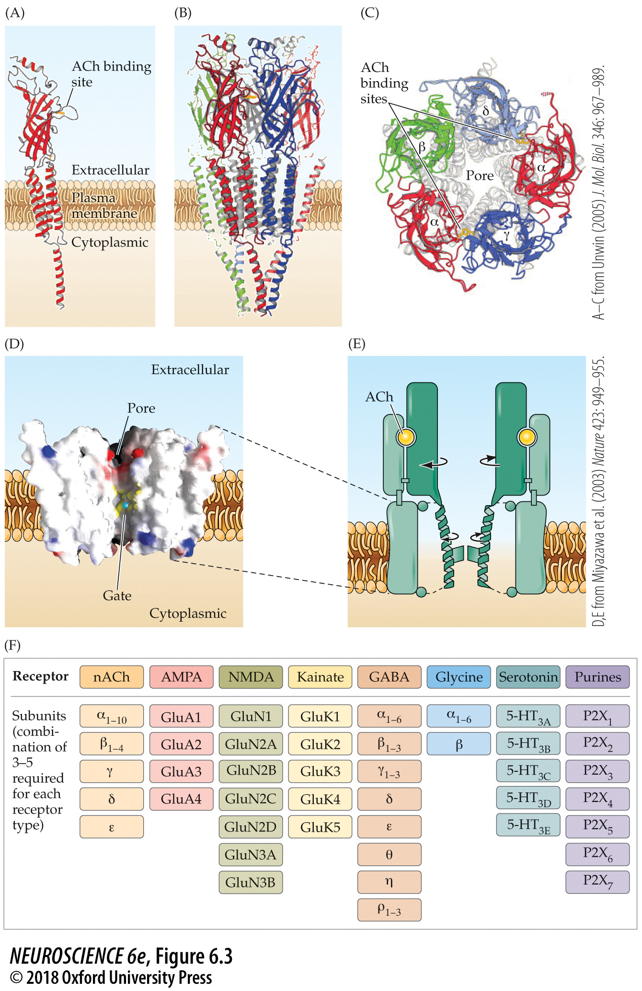
Structure of the nicotinic ACh receptor
Notes:
FIGURE 6.3 Structure of the nicotinic ACh receptor. (A) Structure of the α subunit of the receptor. Each subunit crosses the membrane four times; the α subunit additionally contains a binding site for ACh in its extracellular domain. (B) Five subunits come together to form a complete AChR. (C) View of the AChR from the perspective of the synaptic cleft. The arrangement of the five subunits is evident, with each subunit contributing one transmembrane helix that forms the channel pore. (D) Cross-section view of the transmembrane domain of the AChR. The openings at either end of the channel pore are very large, and the pore narrows at the channel gate. The turquoise sphere indicates the dimension of a sodium ion (0.3 nm diameter). (E) Model for gating of the AChR. Binding of ACh to its binding sites on the two α subunits causes a conformational change in part of the extracellular domain, which causes the pore-forming helices to move and open the pore gate. (F) A diversity of subunits come together to form ionotropic neurotransmitter receptors. (A–C from Unwin, 2005; D, E from Miyazawa et al., 2003.)

Slide 8
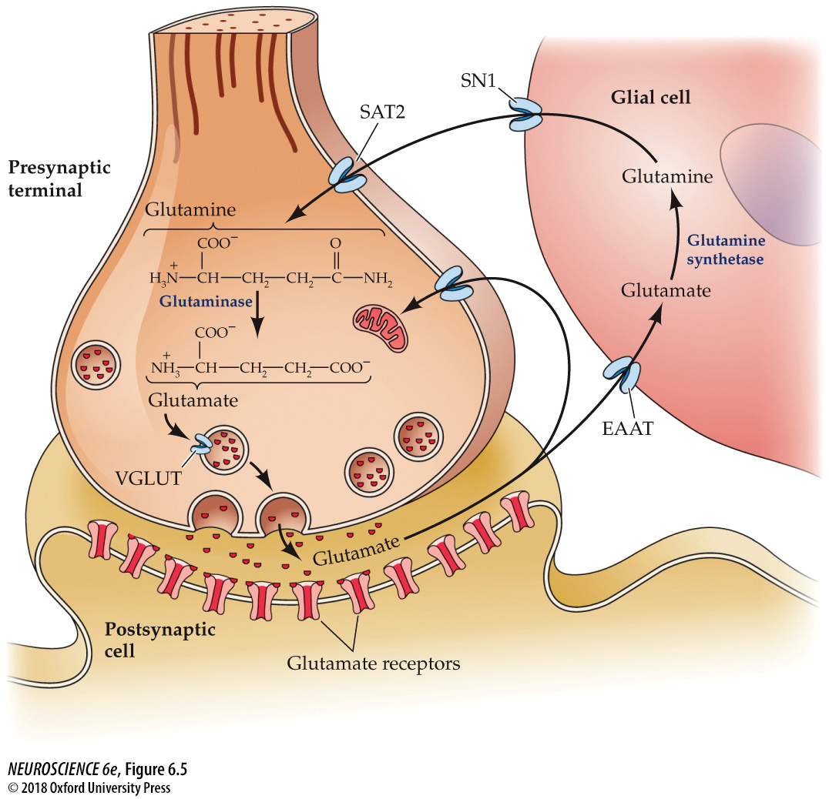
Glutamate synthesis and cycling between neurons and glia
Notes:
FIGURE 6.5 Glutamate synthesis and cycling between neurons and glia. The action of glutamate released into the synaptic cleft is terminated by uptake into surrounding glial cells (and neurons) via excitatory amino acid transporters (EAATs). Within glial cells, glutamate is converted to glutamine by glutamine synthetase and released by glial cells through the SN1 transporter. Glutamine is taken up into nerve terminals via SAT2 transporters and converted back to glutamate by glutaminase. Glutamate is then loaded into synaptic vesicles via vesicular glutamate transporters (VGLUTs) to complete the cycle.

Slide 9
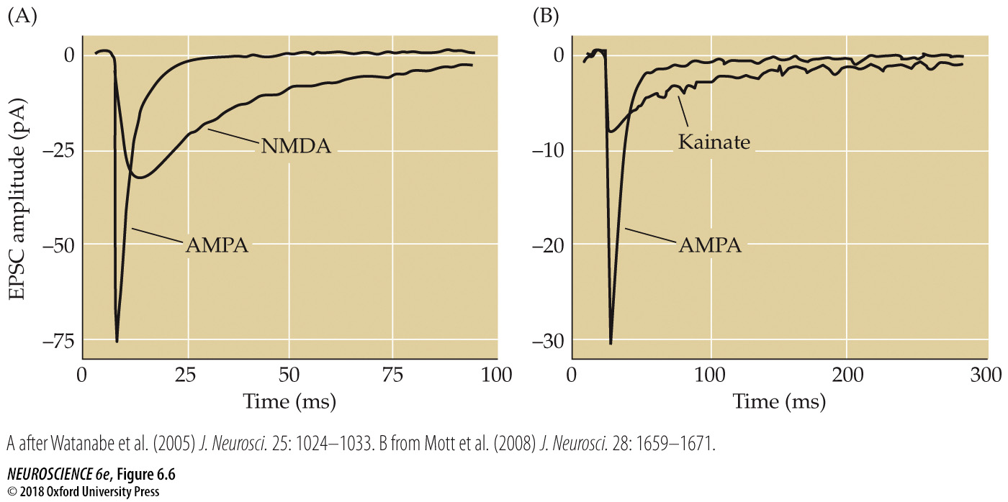
Postsynaptic responses mediated by ionotropic glutamate receptors
Notes:
FIGURE 6.6 Postsynaptic responses mediated by ionotropic glutamate receptors. (A) Contributions of AMPA and NMDA receptors to EPSCs at a synapse between a presynaptic pyramidal cell and a postsynaptic interneuron in the visual cortex. Blocking NMDA receptors reveals a large and fast EPSC mediated by AMPA receptors, while blocking AMPA receptors reveals a slower EPSC component mediated by NMDA receptors. (B) Contributions of AMPA and kainate receptors to miniature EPSCs at the excitatory synapse formed between mossy fibers and CA3 pyramidal cells in the hippocampus. Pharmacological antagonists reveal that the component of EPSCs mediated by AMPA receptors is larger and decays faster than that mediated by kainate receptors. (A after Watanabe et al., 2005; B from Mott et al., 2008.)

Slide 10
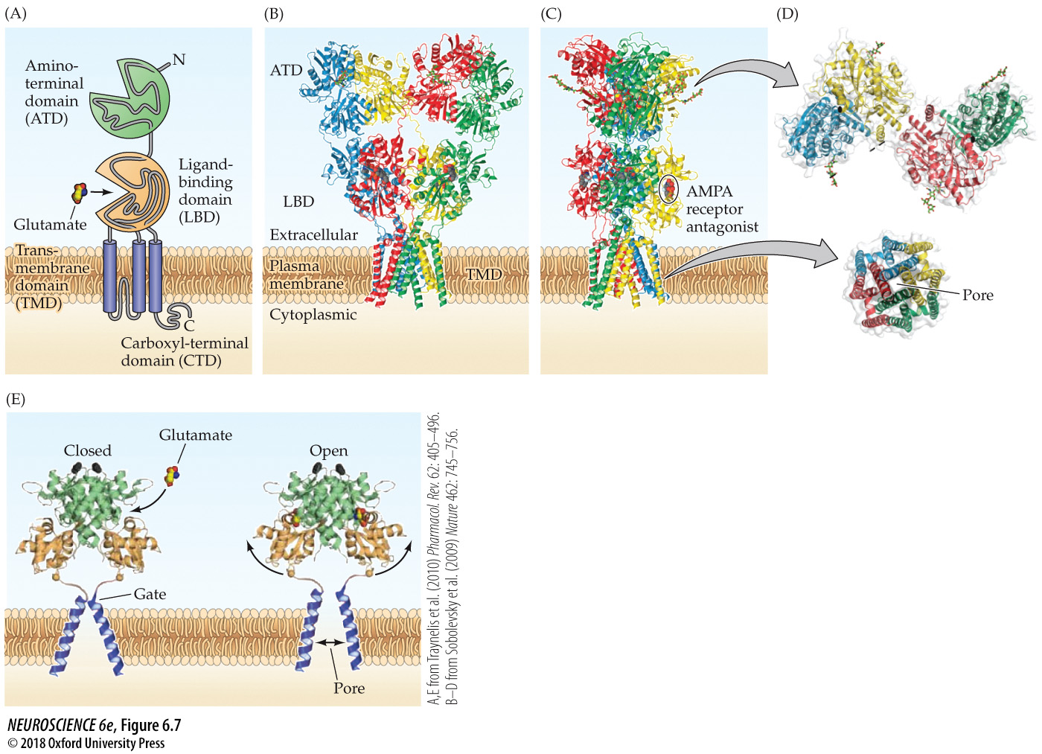
Structure of the AMPA receptor
Notes:
FIGURE 6.7 Structure of the AMPA receptor. (A) Domain structure of an AMPA receptor subunit. The largest part of each subunit is extracellular and consists of two domains, the amino-terminal domain (ATD) and the ligand-binding domain (LBD). In addition, a transmembrane domain (TMD) forms part of the ion channel pore, and an intracellular carboxyl-terminal domain (CTD) connects the receptor to intracellular proteins. (B–D) Crystallographic structure of the AMPA receptor. Each of the four subunits is indicated in a different color. (B) From this perspective, the Y shape of the AMPA receptor is evident. (C) After rotating the receptor 90 degrees, the asymmetrical dimensions of the receptor are evident. One ligand-binding domain is visible and is occupied by an antagonist drug (circled). (D) Cross-section views of the AMPA receptor at two different positions (gray arrows) reveal the spatial relationships between subunits and also illustrate the changes in shape that occur along the length of the receptor. (E) Model for gating of the AMPA receptor by glutamate. The transmembrane domain (blue helices) and part of the extracellular ligand-binding domain are shown. Binding of glutamate closes the clamshell structure of the ligand-binding domain (side arrows), leading to movement of the gate helices that opens the channel pore. (A,E from Traynelis et al., 2010; B–D from Sobolevsky et al., 2009.)

Slide 11
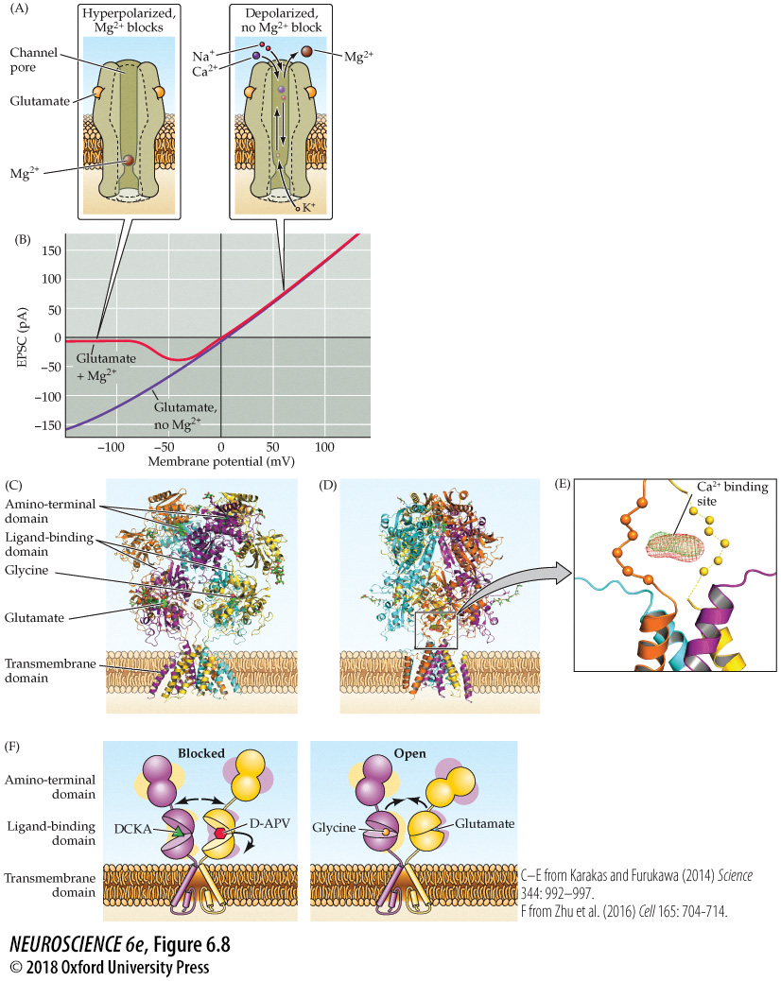
Function and structure of the NMDA receptor
Notes:
FIGURE 6.8 Function and structure of the NMDA receptor. (A) Voltage-dependent block of the NMDA receptor pore by Mg²⁺. At hyperpolarized potentials, Mg²⁺ resides within the channel pore and blocks it (left). Depolarization of the membrane potential pushes Mg²⁺ out of the pore, so that current can flow through the NMDA receptor. (B) Voltage dependence of current flowing through NMDA receptors activated by glutamate. In the presence of Mg²⁺ (red), Mg²⁺ block of the channel pore prevents current flow at hyperpolarized membrane potentials. If extracellular Mg²⁺ is removed, there is no block of the channel pore. (C–E) Crystallographic structure of the NMDA receptor. Each of the four subunits is indicated in a different color: GluN1 subunits are orange and yellow, GluN2 subunits cyan and purple. (C) The structure of the NMDA receptor is similar to that of the AMPA receptor, with an amino-terminal domain, ligand-binding domain, transmembrane domain, and carboxyl-terminal domain. The ligand-binding domain of GluN2A binds to glutamate (green spheres), while the ligand-binding domain of GluN1 binds to the co-agonist, glycine (green spheres). (D) Rotating the receptor 90 degrees reveals the location of the putative binding site for Ca²⁺. (E) Close-up view of the putative Ca²⁺ binding site (red and green mesh) in the extracellular vestibule of the receptor. (F) Model for gating of NMDA receptors. Proposed movements (arrows) of the amino-terminal domain and ligand-binding domain regions of the receptor when bound to antagonists, such as DCKA and D-APV (left), or agonists (glycine and glutamate, right). (C–E from Karakas and Furukawa, 2014; F from Zhu et al., 2016.)

Slide 12
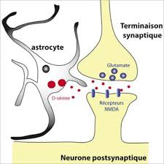

Slide 13
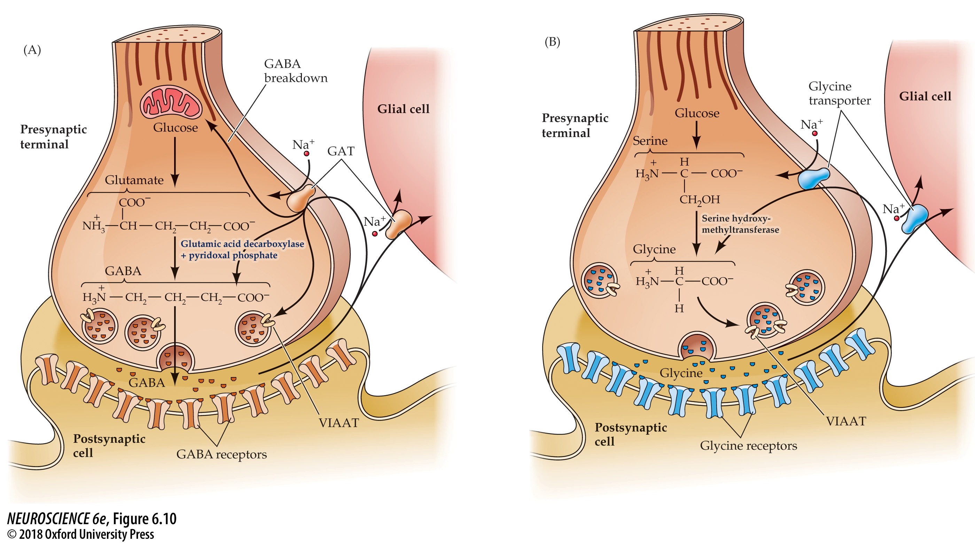
Synthesis, release, and reuptake of the inhibitory neurotransmitters GABA and glycine
Notes:
FIGURE 6.10 Synthesis, release, and reuptake of the inhibitory neurotransmitters GABA and glycine. (A) GABA is synthesized from glutamate by the enzyme glutamic acid decarboxylase, which requires pyridoxal phosphate. (B) Glycine can be synthesized by several metabolic pathways; in the brain, the major precursor is serine. High-affinity transporters terminate the actions of these transmitters and return GABA or glycine to the synaptic terminals for reuse, with both transmitters being loaded into synaptic vesicles via the vesicular inhibitory amino acid transporter (VIAAT).

Slide 14
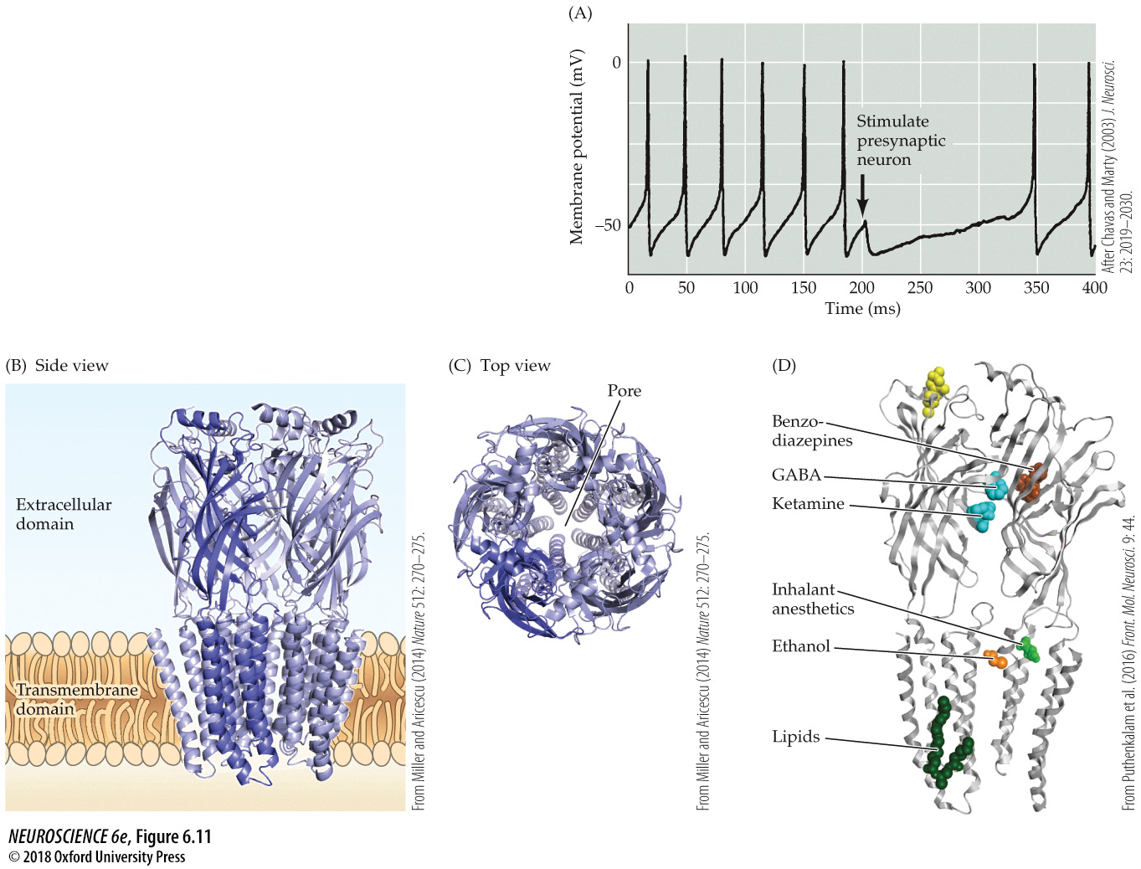
Ionotropic GABA receptors
Notes:
FIGURE 6.11 Ionotropic GABA receptors. (A) Stimulation of a presynaptic GABAergic interneuron, at the time indicated by the arrow, causes a transient inhibition of action potential firing in the postsynaptic target. This inhibitory response is caused by activation of postsynaptic GABA_{A} receptors. (B–D) Crystallographic structure of a GABA_{A} receptor. (B) The receptor is formed from five subunits, each containing an extracellular domain and a transmembrane domain. One subunit is highlighted in blue. (C) This extracellular perspective shows the pore formed by the transmembrane domains of the receptor subunits. (D) View of two receptor subunits, indicating the binding sites for numerous ligands. Here the GABA binding site is occupied by benzamidine, a GABA_{A} receptor agonist. (A after Chavas and Marty, 2003; B,C from Miller and Aricescu, 2014; D from Puthenkalam et al., 2016.)

Slide 15
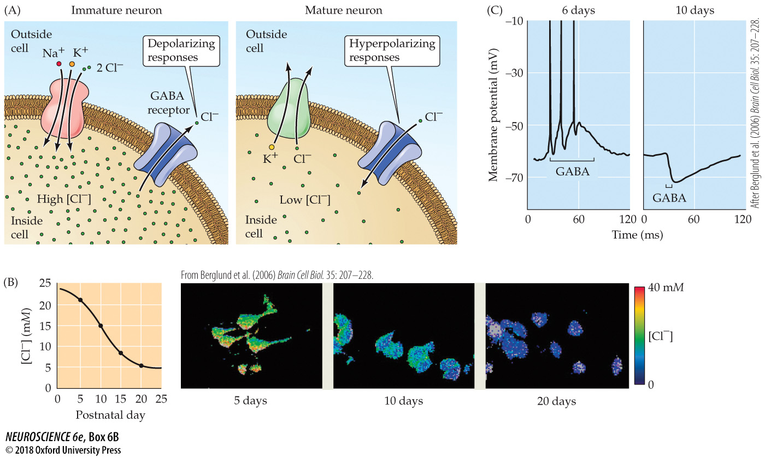
Excitatory Actions of GABA in the Developing Brain
Notes:
BOX 6B Excitatory Actions of GABA in the Developing Brain
(A) The developmental switch in expression of Cl– transporters lowers [Cl–]_{i}, thereby reversing direction of Cl– flux through GABA receptors. (B) Imaging [Cl–]_{i} between postnatal days 5 and 20 (right) demonstrates a progressive reduction in [Cl–]_{i} (left). (C) Developmental changes in [Cl–]_{i} cause GABA responses to shift from depolarizing in young (6-day-old) neurons (left) to hyperpolarizing in older (10-day-old) neurons (right) cultured from the chick spinal cord. (B from Berglund et al., 2006; C after Obata et al., 1978.)

Slide 16
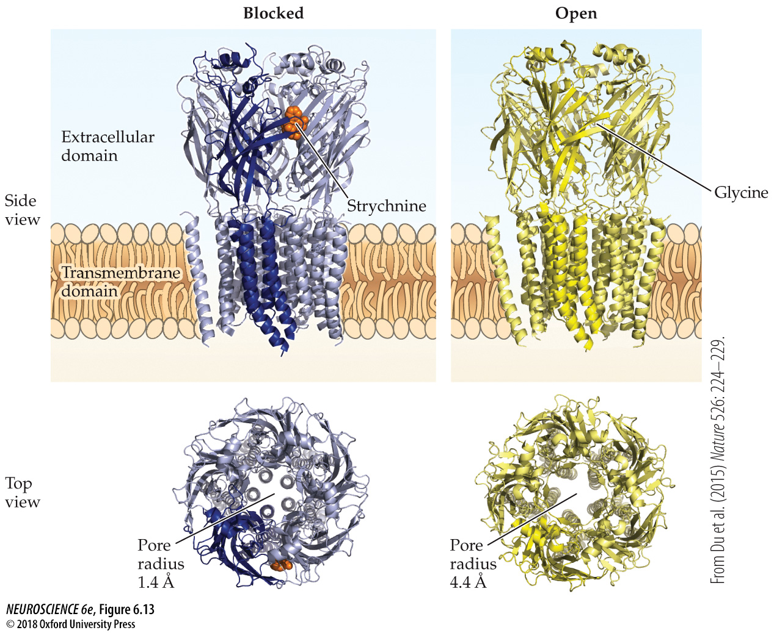
Gating of glycine receptors
Notes:
FIGURE 6.13 Gating of glycine receptors. Similar to GABA_{A} receptors, glycine receptors are pentamers consisting of five subunits. Each subunit (one of which is highlighted) consists of an extracellular domain and a pore-forming transmembrane domain. (Left) Binding of strychnine (orange) to a ligand-binding site on the extracellular domain closes the channel pore. (Right) Binding of glycine to the same ligand-binding site causes a conformational change that opens the pore. (From Du et al., 2015.)

Slide 17
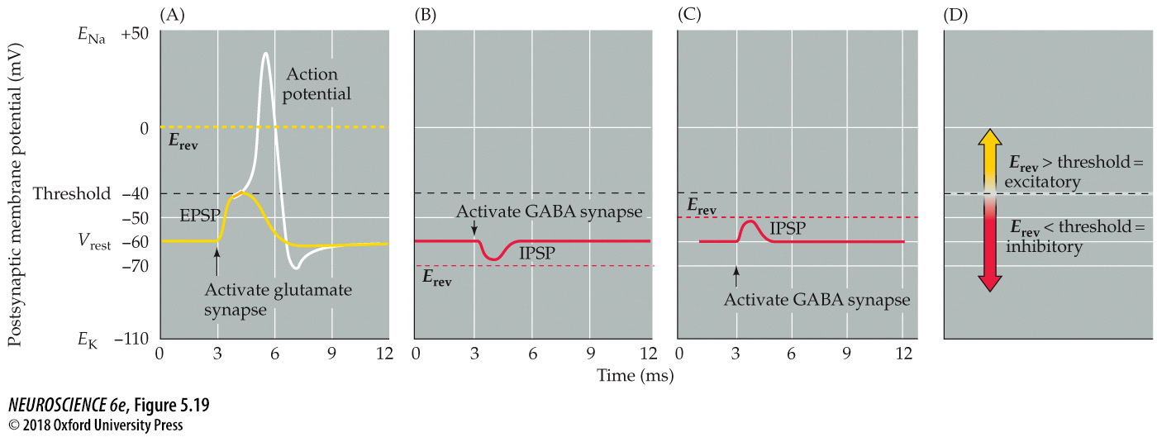
Reversal potentials and threshold potentials determine postsynaptic excitation and inhibition
Notes:
FIGURE 5.19 Reversal potentials and threshold potentials determine postsynaptic excitation and inhibition. (A) If the reversal potential for a PSP (0 mV) is more positive than the action potential threshold (–40 mV), the effect of a transmitter is excitatory, and it generates EPSPs. (B) If the reversal potential for a PSP is more negative than the action potential threshold, the transmitter is inhibitory and generates IPSPs. (C) IPSPs can nonetheless depolarize the postsynaptic cell if their reversal potential is between the resting potential and the action potential threshold. (D) The general rule of postsynaptic action is: If the reversal potential is more positive than threshold, excitation results; inhibition occurs if the reversal potential is more negative than threshold.

Slide 18
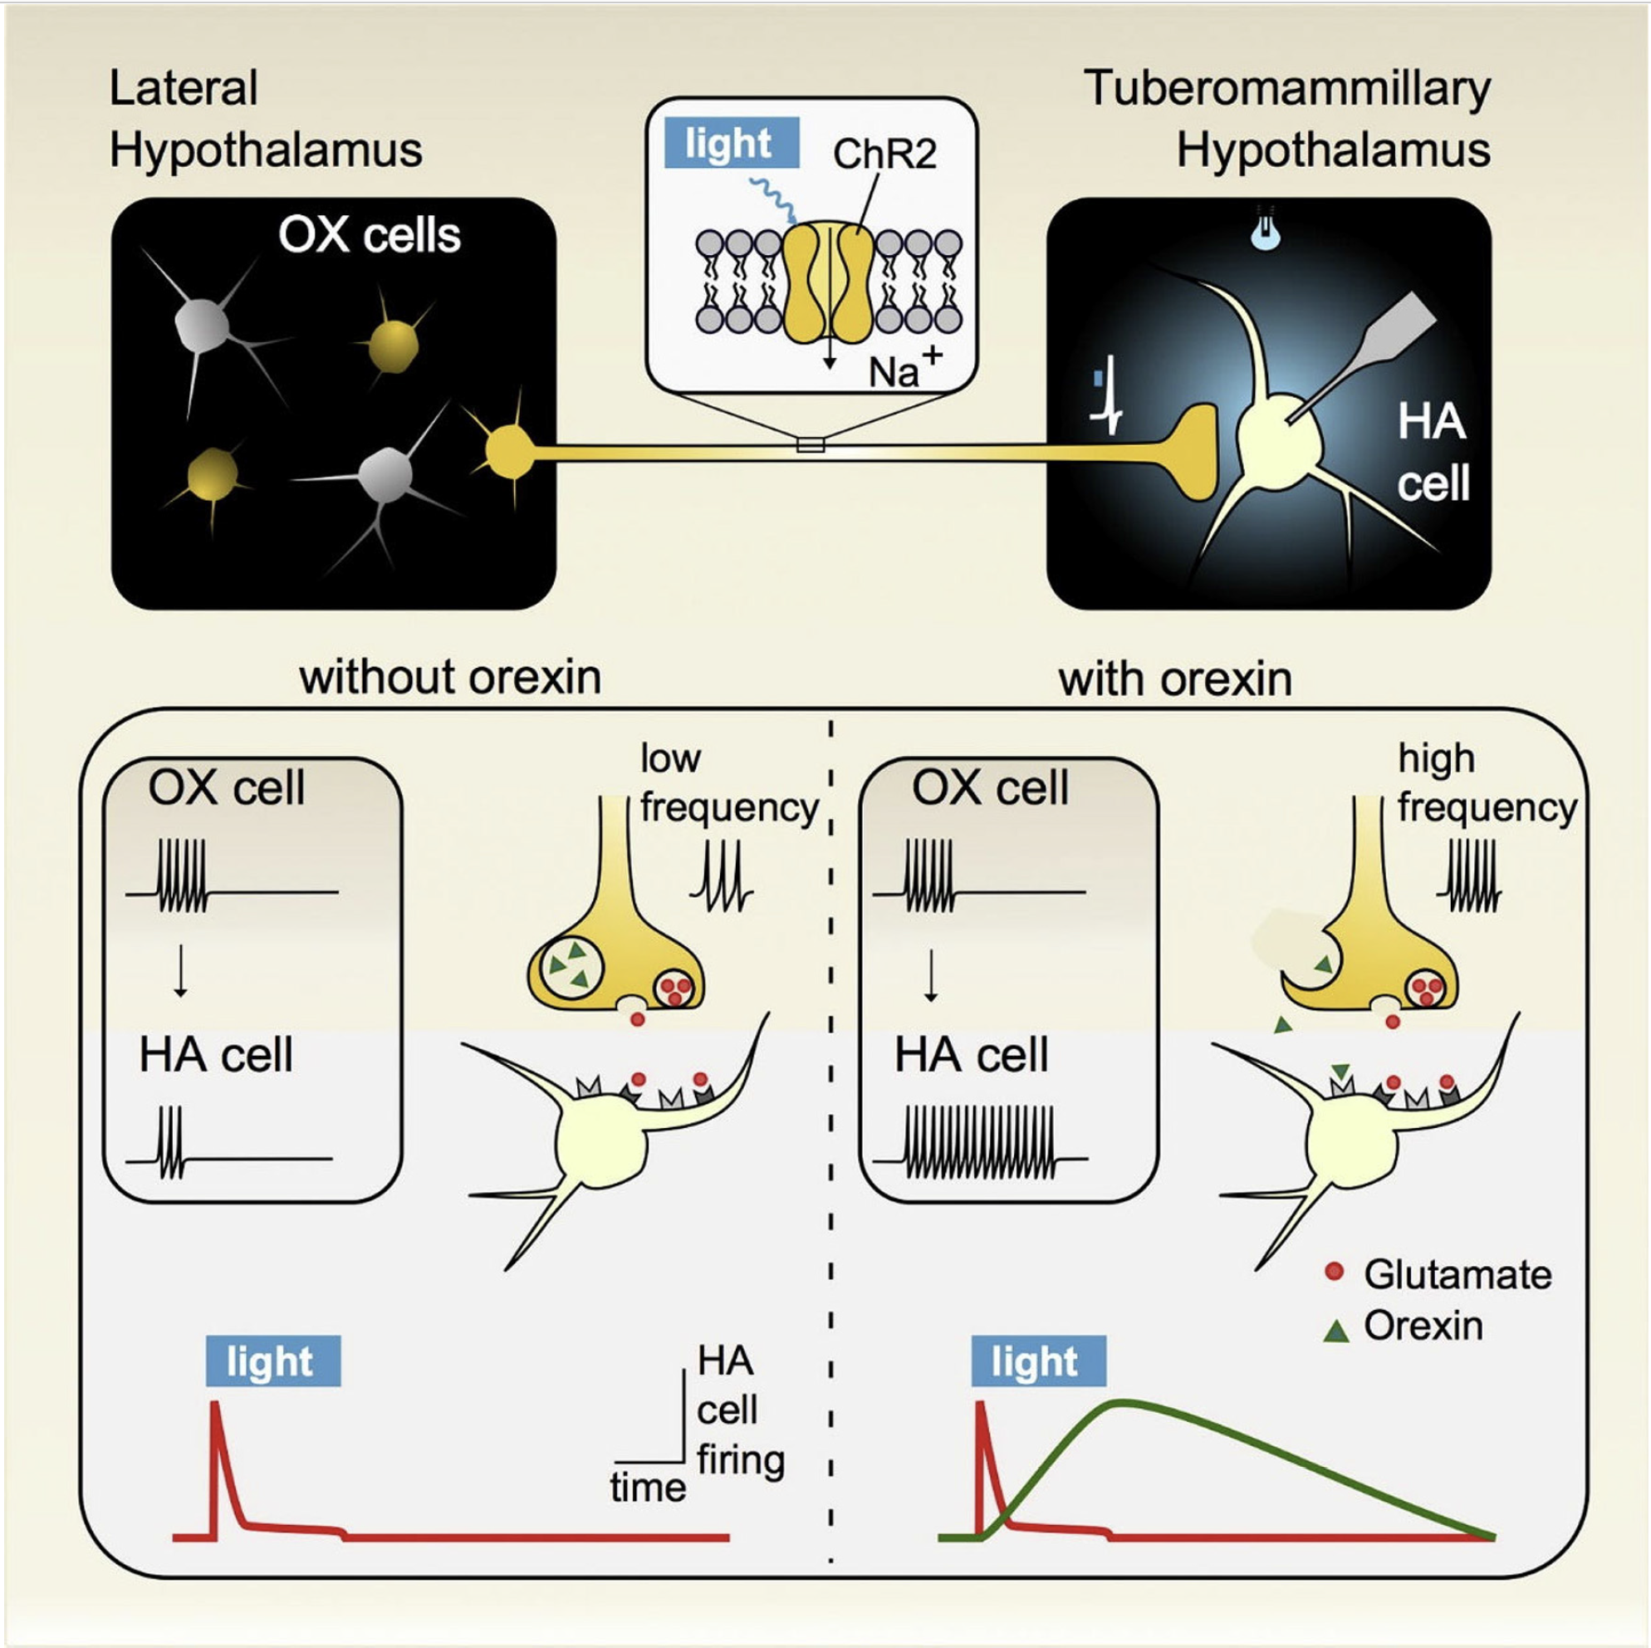
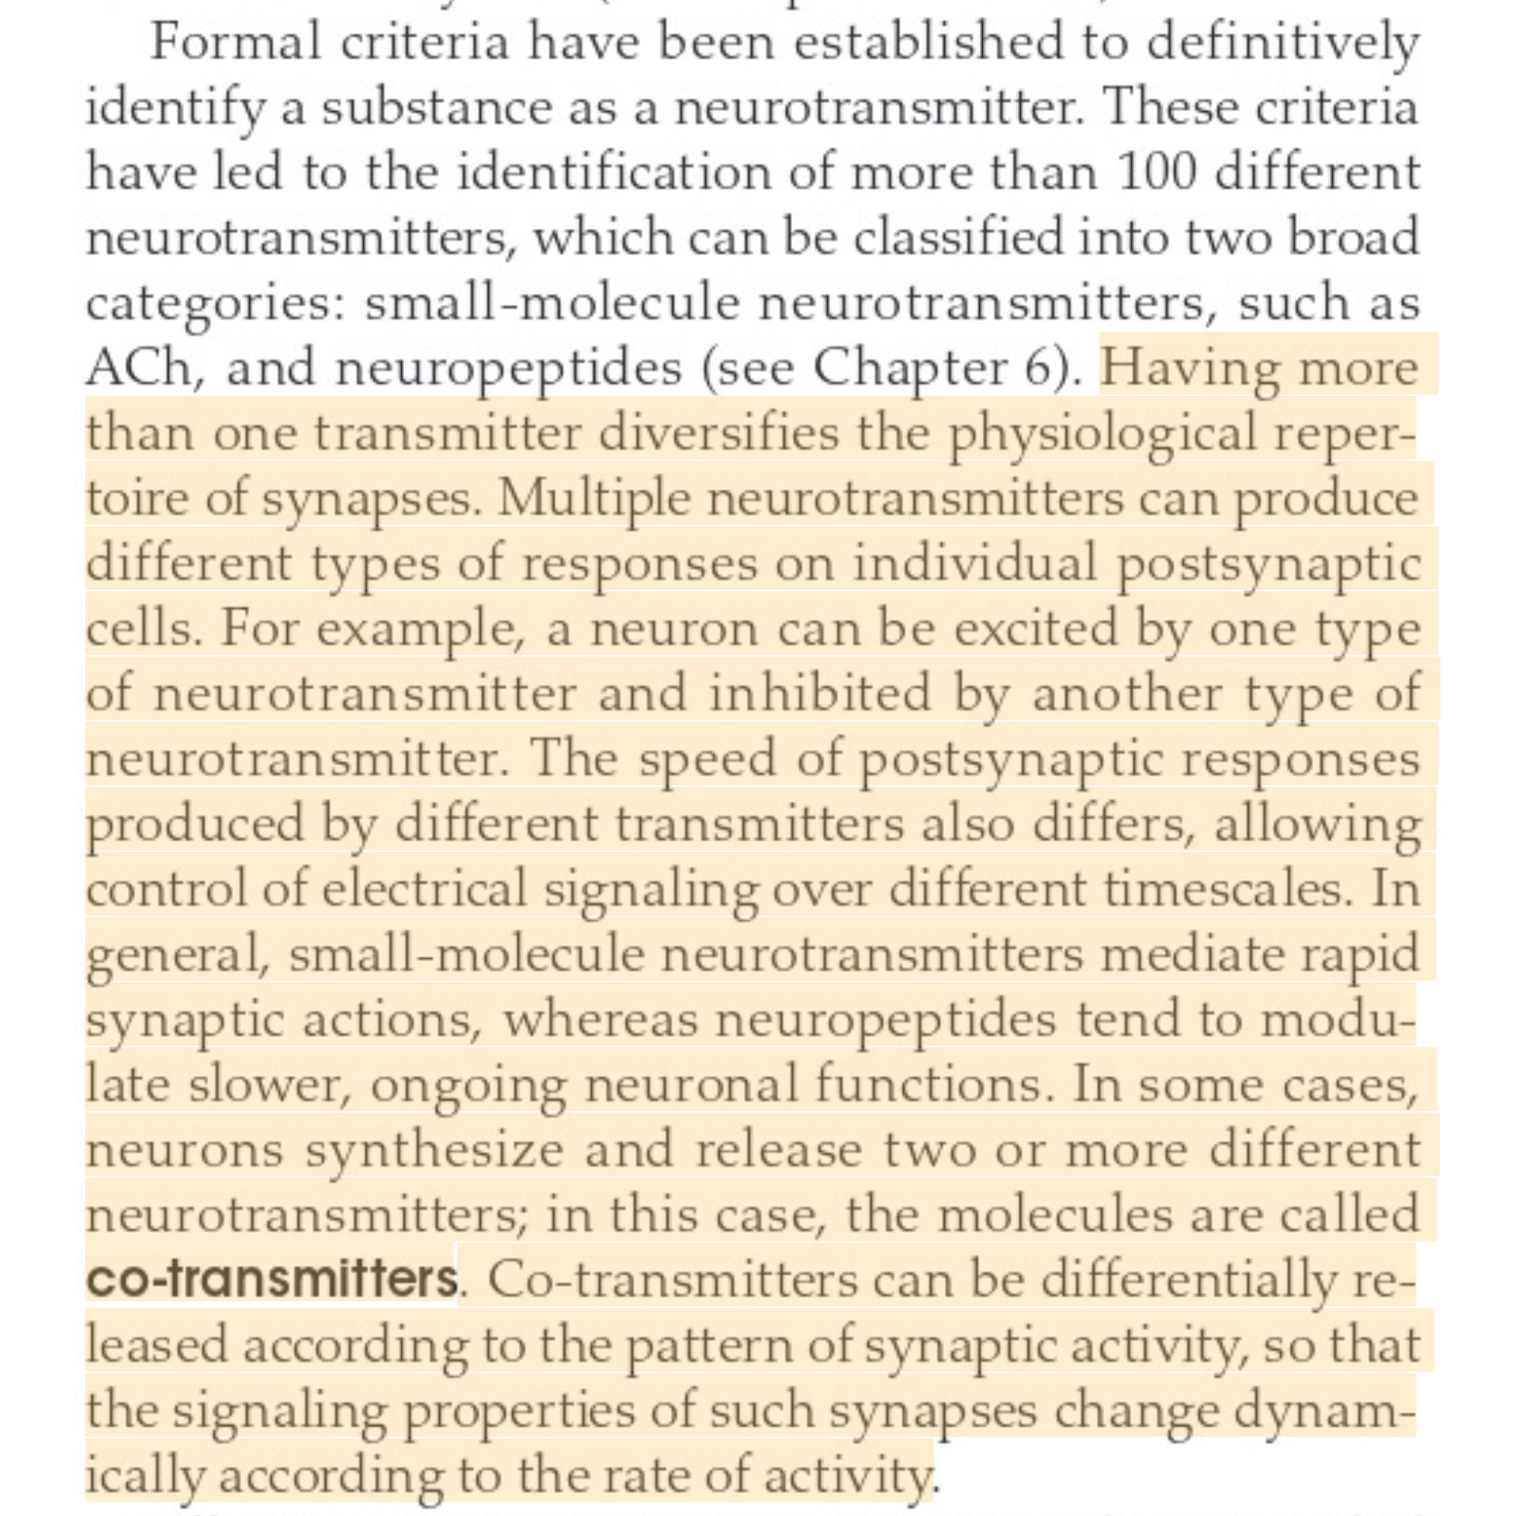
How many neurotransmitters does one neuron receive, and how many can it release?
Chap 5, p.89:
From: General Principles of Neuronal Co-transmission: Insights From Multiple Model Systems
By Erik Svensson et al. 2019

Slide 19
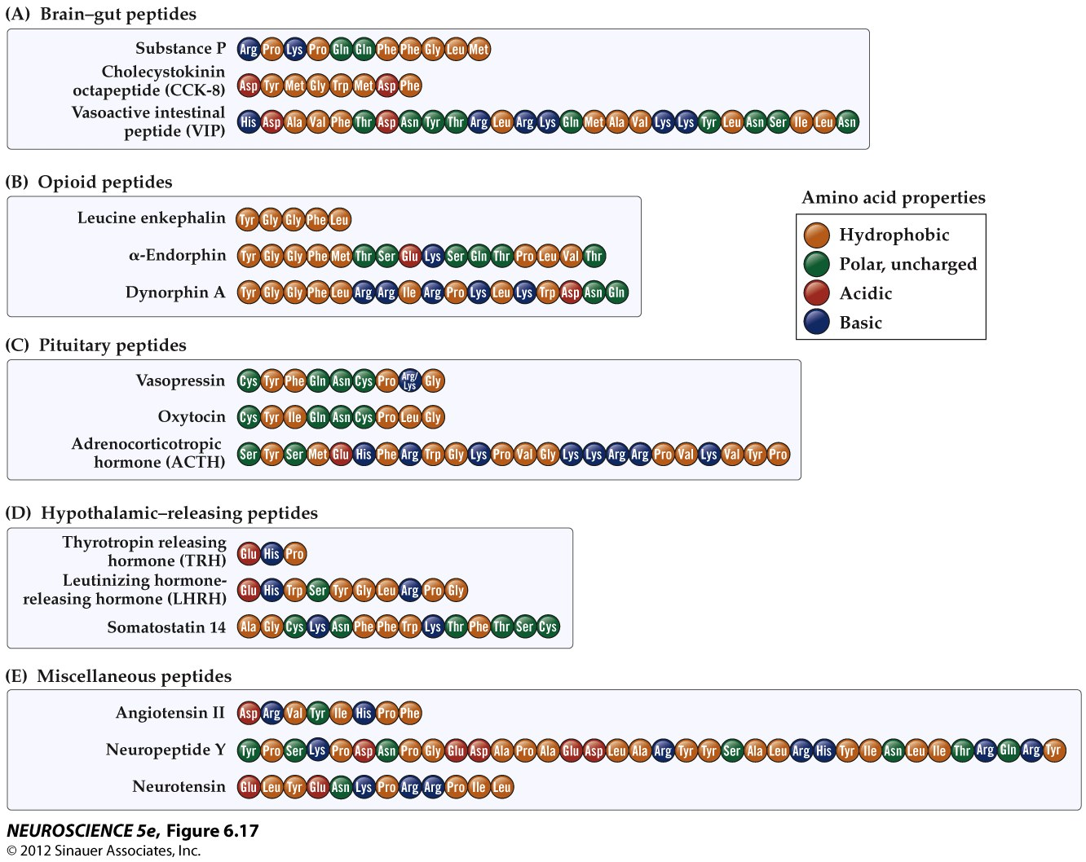
Amino acid sequences of neuropeptides

Slide 20
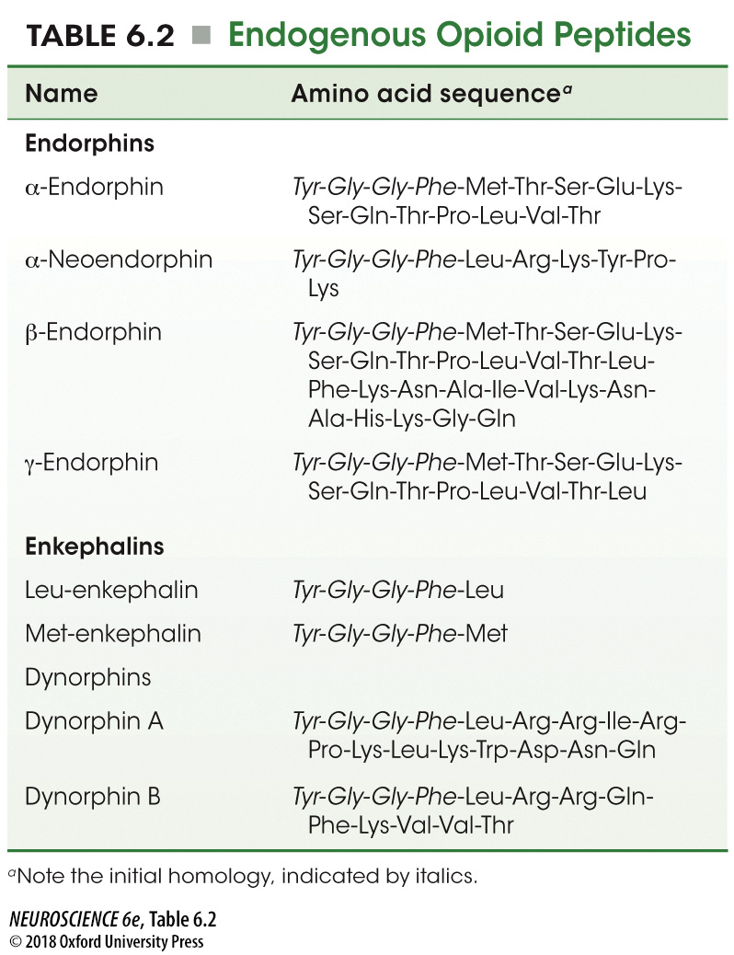
Endogenous Opioid Peptides
Notes:
TABLE 6.2 Endogenous Opioid Peptides

Slide 21
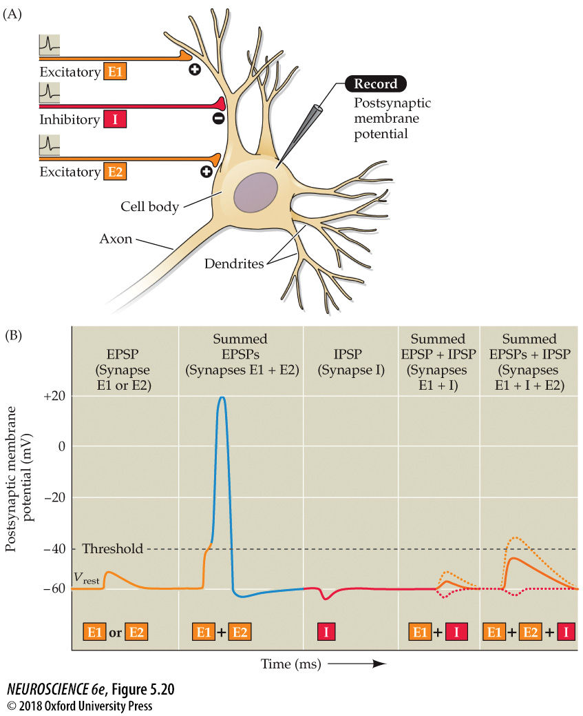
Summation of postsynaptic potentials
Notes:
FIGURE 5.20 Summation of postsynaptic potentials. (A) A microelectrode records the postsynaptic potentials produced by the activity of two excitatory synapses (E1 and E2) and an inhibitory synapse (I). (B) Electrical responses to synaptic activation. Stimulating either excitatory synapse (E1 or E2) produces a subthreshold EPSP, whereas stimulating both synapses at the same time (E1 + E2) produces a suprathreshold EPSP that evokes a postsynaptic action potential (shown in blue). Activation of the inhibitory synapse alone (I) results in a hyperpolarizing IPSP. Summing this IPSP (dashed red line) with the EPSP (dashed yellow line) produced by one excitatory synapse (E1 + I) reduces the amplitude of the EPSP (solid orange line), while summing it with the suprathreshold EPSP produced by activating synapses E1 and E2 keeps the postsynaptic neuron below threshold, so that no action potential is evoked.

